Slide 1
TwinStrand Panel – v4
3/12/2021
Jason Kunisaki

Slide 2
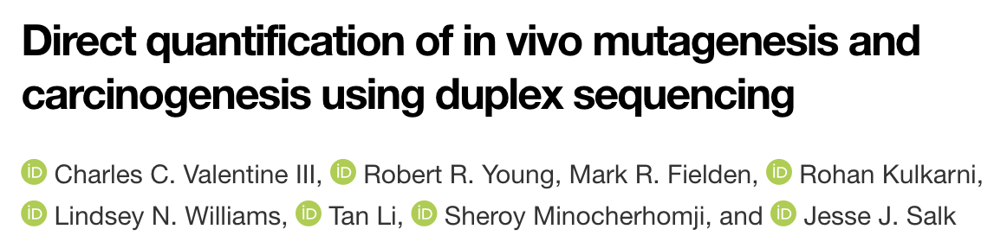
TwinStrand cost calculator and power simulation
Cost calculator: https://docs.google.com/spreadsheets/d/1wc3_G-OO8Bs_5sRdWxX_65djseOmF7hhgvHEHQ3my0k/edit#gid=42595536
Power simulation: see shiny app
Allele count: “collect variants of any alternate allelic count greater than, or equal to, one”
Coverage cII reporter gene: “mean duplex depth of 39,668x”
Coverage HRAS transgene: “mean duplex depth of 9,012x”

Slide 3
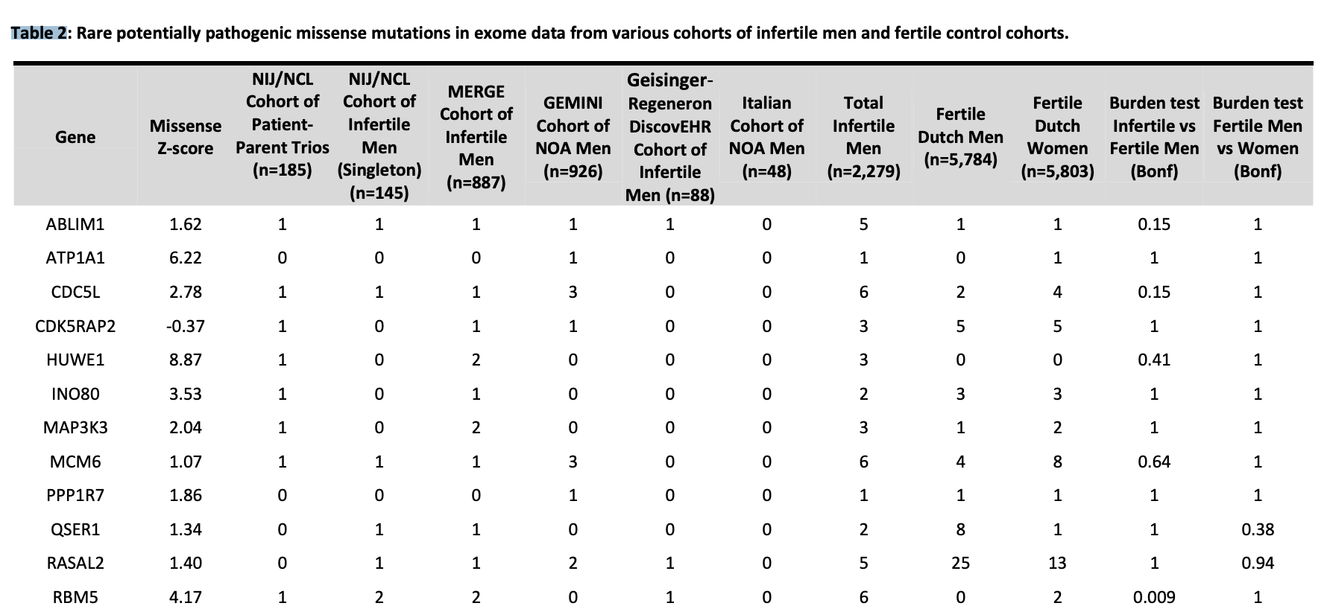
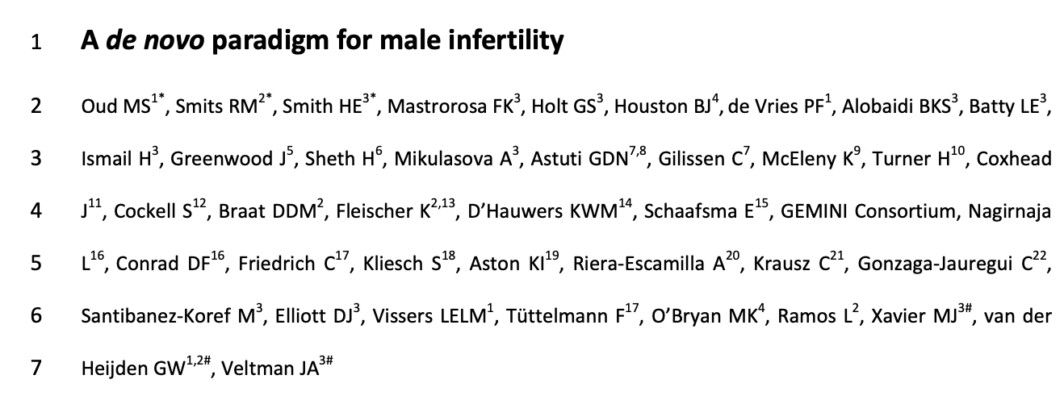
More genes to add?
RBM5 (O’Bryan et al, 2013)
Regulates pre-mRNA splicing
Essential for spermatid differentiation
HUWE1 (Bose et al, 2017)
Ubiquitin ligase → ubiquinate histones
HUWE1 inactivation → spermatogonia depletion
Due to H2AX accumulation that damages DNA → signals for apoptosis
Not essential for meiotic progression
RBM5 burden test | Pathogenic (LoF and missense) | Not Pathogenic (LoF and missense)
Fertile fathers | Low | High
Infertile probands | High | Low
Notes:
KIWI and PIWI
look at genes with z-score > 1.5 and pick 1-2 more

Slide 4
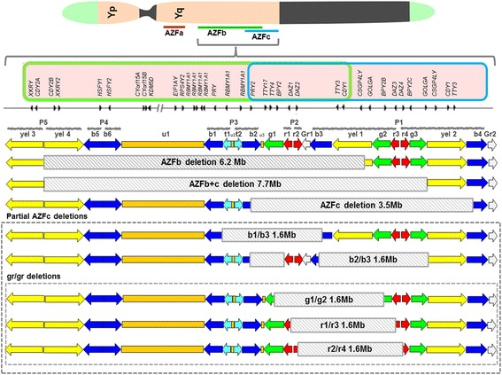
AZFc genes of interest
See: ~/git/spermseq/twinstrand_target_gene_set/output/merged_exons_final.txt
DAZ:
Palindromic duplication as two clusters of four genes
Has autosomal homologs
RNA-binding protein to regulate translation of genes
CDY1A/B
2 copies
Has near-paralogs on P5
Histone acetyltransferase
CDY1B deletion --> oligo (Ghorbel et al, 2014)
Deletions are not always associated with infertility
Notes:
≈

